Slide 1

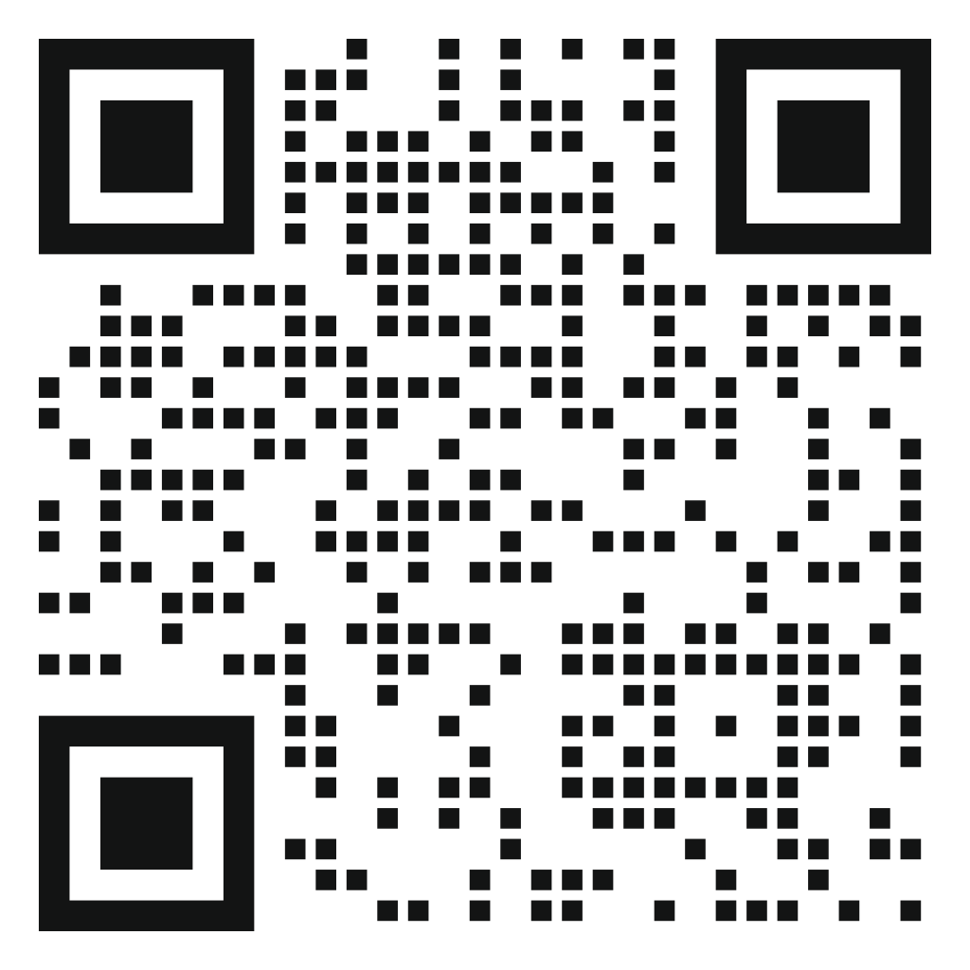
SUBMIT YOUR ABSTRACT NOW
Submission Deadline: 15 April

