Slide 1
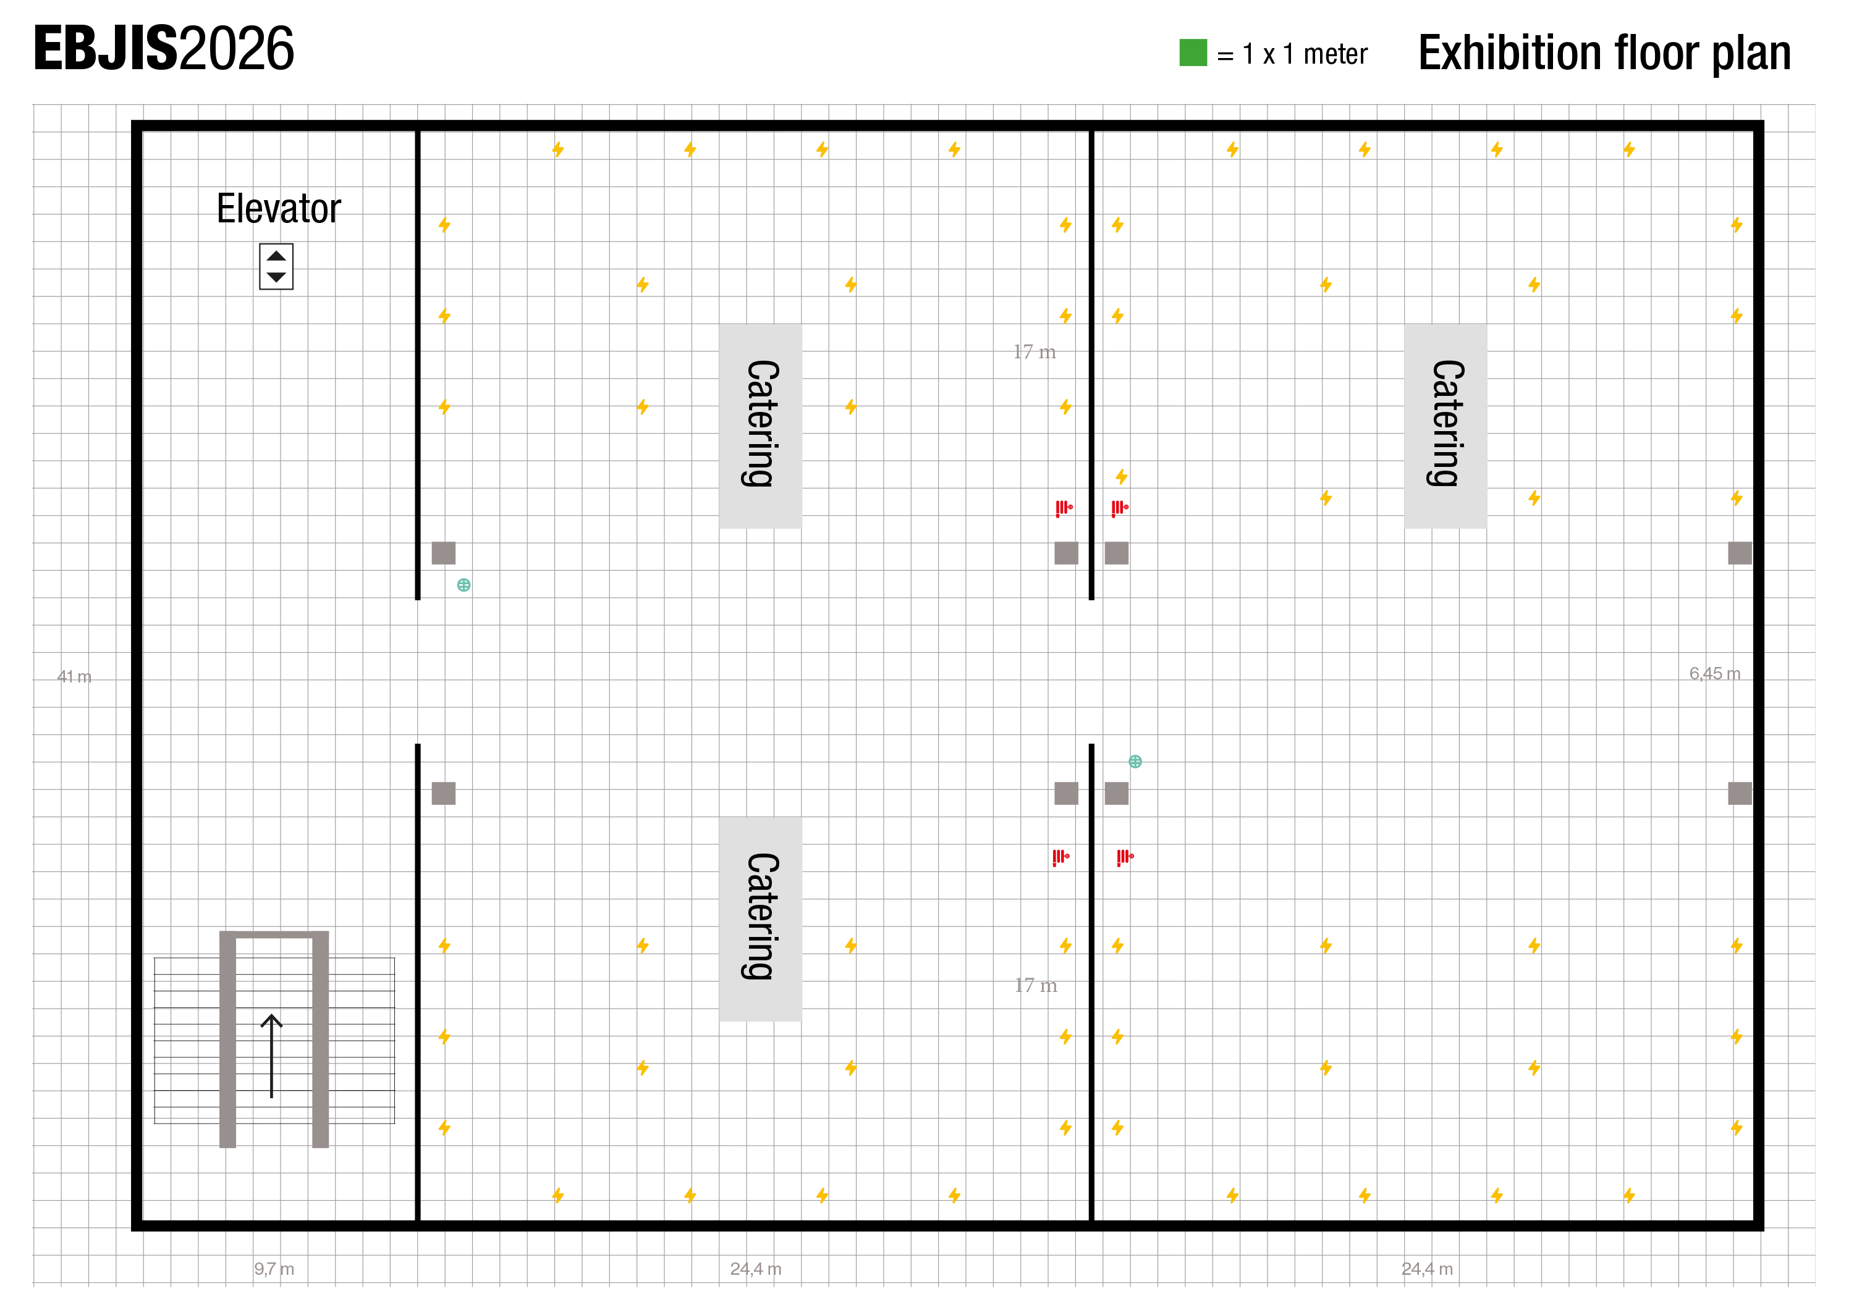

EBJIS-MSIS 2026
9
Zimmer Biomet
10
11
12
Summit
Medical
Reserved
Globus
Medical
Reserved
20
3x3 m
6x3 m
3x3 m
3x3 m
5x3m
StiehlTech
3x2 m
Depuy
Reserved
Osartis /Tecres
Solenic Medical
G21
3x2 m
3x2 m
3x2 m
3x2 m
17
18
19
21
Onkos Surgical
3x2m
3x3 m
8
Resorba
8x3 m
15
22
Access to session rooms
3x3 m
13
BONESUPPORT
5x3 m
6x3 m
6x3 m
BioMérieux
7
Bonalive
14
23
Osteal Therapeutics
Registration
Entrance to
catering
preparation area
8x3 m
8x3 m
3x3 m
3x3 m
3x3 m
3x3 m
24
25
26
27
1
Heraeus Medical
6
Biocomposites
Catering
preparation area
2
Smith & Nephew
3
Arthrex
4
InfectoPharm
5
Paul Hartmann
Entrance
to 2nd Floor
3x3 m
3x3 m
5x3m
6x3 m

Slide 2
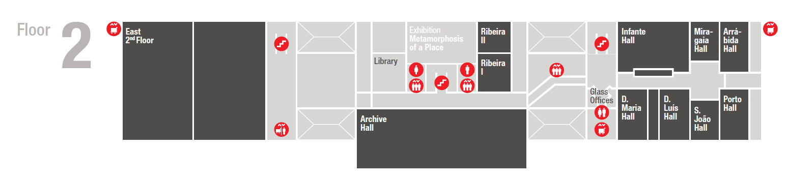
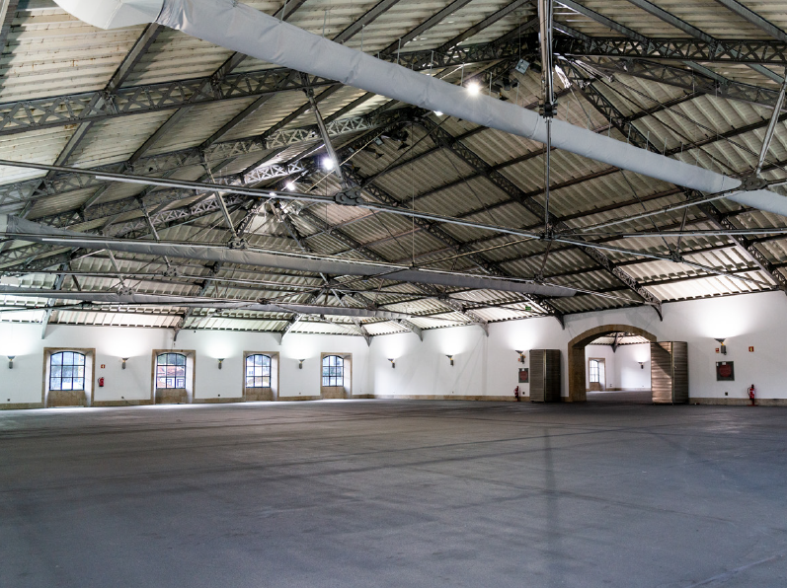
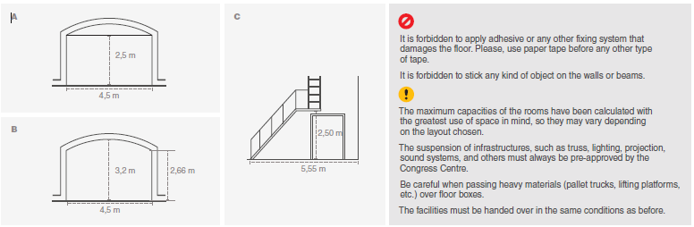
Venue floorplan
All conference rooms are located on 2nd floor
Session
Room
Booths
Plenary Room
= Exhibitor
= Bronze sponsor
= Silver sponsor
The exhibition room
East 2nd floor
= Gold sponsor
= Platinum sponsor

